Slide 1
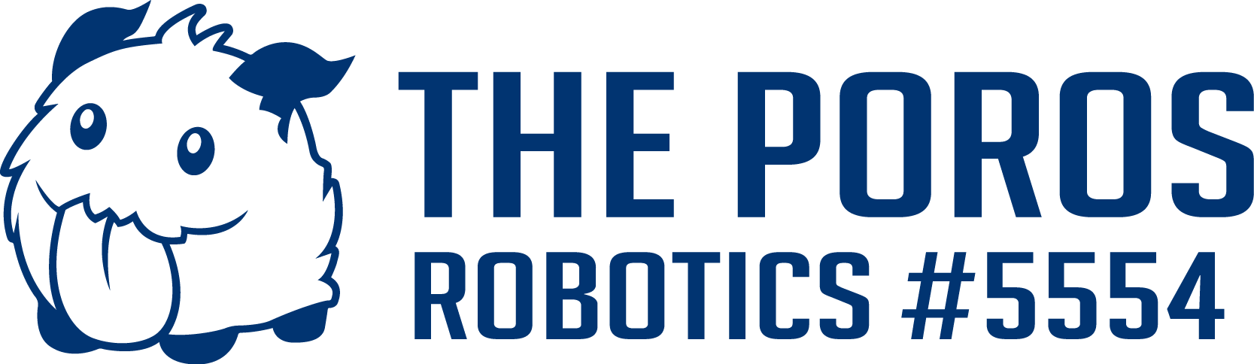
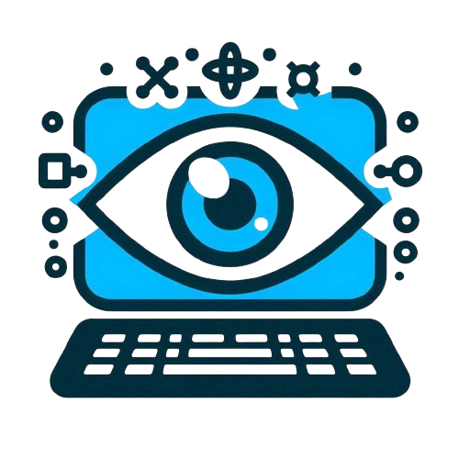
Vision on Raspberry pi
Authors:
Yoav Rozov

Slide 2
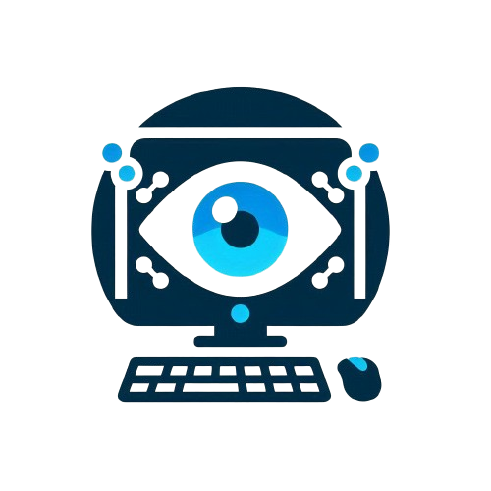
Why and when?

Slide 3
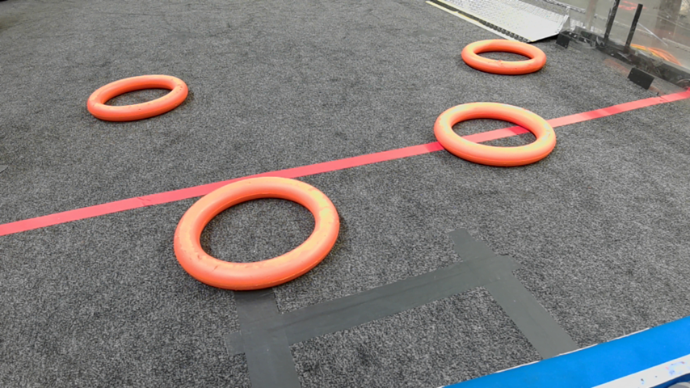
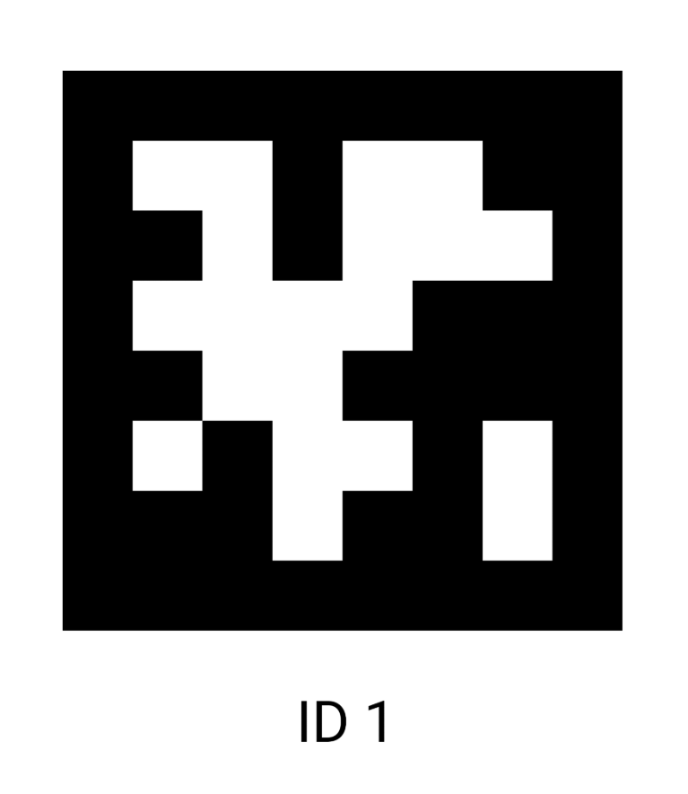
Why?
We will use computer vision for two main purposes which we will address separately:
Detecting game objects, for example: notes, cones, cubes…
Detecting Apriltags that are present in the field (Those strange barcodes)
Notes:
אני אתמקד בעיקר בזיהוי חלקי ומציאת המיקום שלהם ביחס לרובוט, זה משום שזיהוי תאגים נעשה בצורה זהה כל שנה וזיהוי חלקי משחק משתנה.

Slide 4
Tools

Slide 5
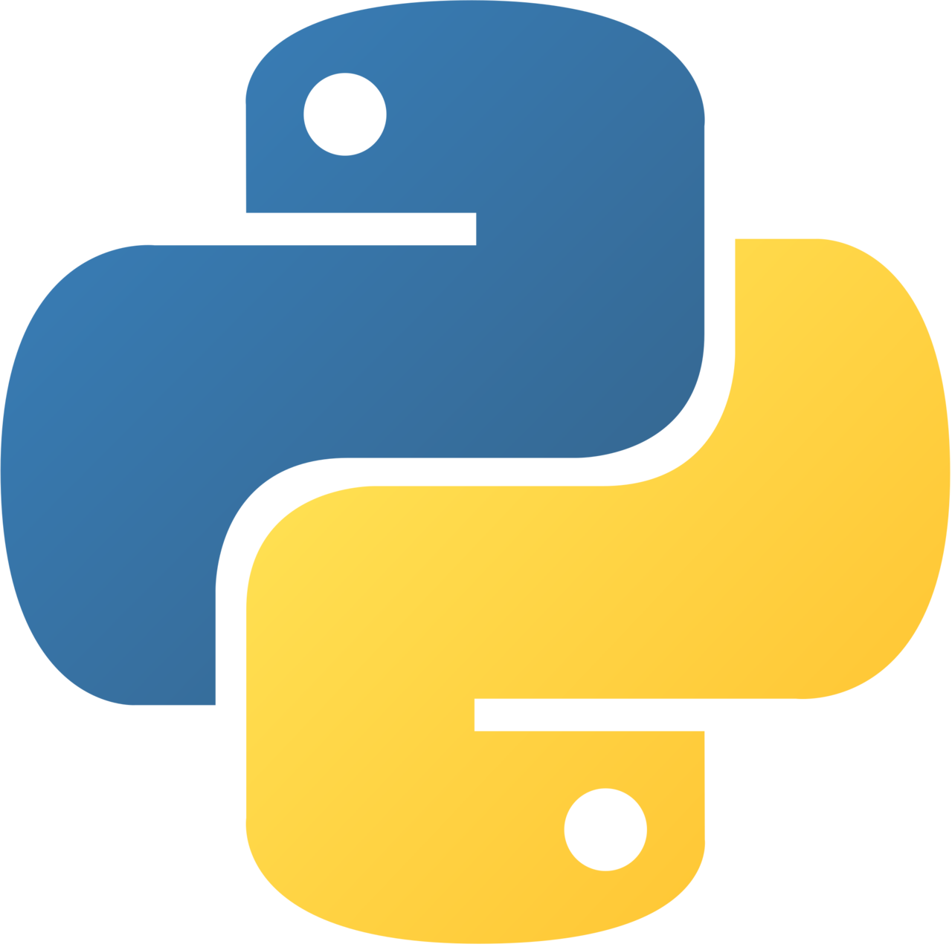
Python
The code for vision that runs on the raspberry pi is written in python.
(Full installation guide here)
We will be using the following python libraries:
OpenCv
Numpy
Pandas
Scipy
Before reading the rest of this presentation you must be familiar with python.
Here are two YouTube videos to learn python:
Quick reminder
Longer Tutorial
Notes:
אנחנו משתמשים בפייטון בגלל שזה קל יותר ופשוט יותר בהשוואה לשפות אחרות

Slide 6

Open CV
Open Computer Vision Library, OpenCV for short is a very big and powerful computer vision library, it is primarily written in c++ which means it is usually very fast. OpenCV has a lot of functions, algorithms and complex use cases, but we will be focusing only at a very small part of the library.

Slide 7
Let’s code it
Python notebook

